Slide 1

Introduction
Effective business processes help an organization to ensure that the organizational goals are met and the customers are satisfied. These business processes are created, managed, and implemented by the employees in the organization. Organization uses different information systems to achieve business process specific goals. An understanding of common business processes will help IT professionals to implement business processes in an organization effectively.
Notes:
This course, “Business Process Fundamental”, consists of two books.
The first book covers the common business processes of an organization and the need for integration of these business processes with Information Systems. This course covers the financial accounting process in detail because this process is considered to be one of the key processes in an organization. In addition to managing the financial process, maintaining good customer relationship is the primary focus of an organization.
Therefore, the second book covers the customer relationship

Slide 2
Objectives
In this session, you will learn to:
  Identify the organizational structure and business ethics
Notes:
Use the slide to explain the objective of the sessions to students. This session will help the student recognize functions and processes within a business organization.

Slide 3

Identifying the Organizational Structure and Business Ethics
What is a business organization?
Notes:
Use the slide and the next slide to initiate a classroom discussion by introducing business processes and the need to be familiar with them in any business organization.
Organizational Setup
Based on Profit
All organizations work for commercial gain. Examples of organizations that are based on profit include:
NIIT, Wipro, and Ranbaxy.
However, some organizations may not have commercial gains as the key focus area. Examples include:
Red Cross and World Health Organization (WHO). Red Cross collects money in the form of charity and donations, and then utilizes these funds for providing social services to the people.
Based on System Type
A system is a group of interdependent components that perform their respective functions to achieve the end objective or goal of the organization.
An organization’s system type should be steadied in isolation. The same system could be considered open or closed depending on the perspective and the factors one is considering for discussion.
Cite the following examples while discussing the classification of organizations based on system types:
Simple/Complex:
Consultancy firms in the corporate world have a limited number of processes, but these are well defined.
Architects on the other hand do not have any well-defined processes.
Adaptive/Non Adaptive:
The size, complexity and functions that an organization carries to meet its objectives define the type of system it adopts or adapts. The food industry is very adaptive as compared to the automobile industry. The automobile industry needs to take many more factors into account before deciding on a change.
Usually bigger companies take a longer time to adapt as compared to the smaller ones.
In traditional systems performance, measurement parameters and scope are missing, for example the government-run departments. Traditional systems are driven by a 'boss', but contemporary systems are driven by a 'leader'.
Based on Ownership
A Corporation is organized and governed by articles of law. Examples of some laws: Companies Act, 1956, Competition Act, 2002, etc.
Sole proprietorship:
Advantages: Sole proprietorship is simple and flexible. The business set up can be established, bought, sold, modified or closed in a short time span. No organizational level charters or bylaws are required for this type of business venture. Other than the normal permits or licenses required for any business activity, no public notifications or legal issues are required for starting, terminating, redirecting, or modifying the business. A single family (proprietor) can own the business so the size or the complexity of the business can change if the proprietor has the finances available.
Limitations: The proprietor and family own the risk both personally and professionally unless assets (the property or funds owned by an individual or organization) are safeguarded, by creating a trust or treating them as separate entities. There may not be enough resources to support the business and hence limited capacity to respond to business opportunities. The business might end with the demise of the proprietor so the next generation must purchase or inherit the business assets by paying the applicable taxes and costs. Merging of household and business finances makes it difficult to measure the performance of the business in terms of profitability and performance. Conflicts in the family, if the family is involved in the business, can paralyze the business processes and functions leading to loss of revenue.

Slide 4

Identifying the Organizational Structure and Business Ethics (Contd.)
A business organization consists of a group of people working specifically for profitability.
Notes:
Use the slide and the next slide to initiate a classroom discussion by introducing business processes and the need to be familiar with them in any business organization.
Organizational Setup
Based on Profit
All organizations work for commercial gain. Examples of organizations that are based on profit include:
NIIT, Wipro, and Ranbaxy.
However, some organizations may not have commercial gains as the key focus area. Examples include:
Red Cross and World Health Organization (WHO). Red Cross collects money in the form of charity and donations, and then utilizes these funds for providing social services to the people.
Based on System Type
A system is a group of interdependent components that perform their respective functions to achieve the end objective or goal of the organization.
An organization’s system type should be steadied in isolation. The same system could be considered open or closed depending on the perspective and the factors one is considering for discussion.
Cite the following examples while discussing the classification of organizations based on system types:
Simple/Complex:
Consultancy firms in the corporate world have a limited number of processes, but these are well defined.
Architects on the other hand do not have any well-defined processes.
Adaptive/Non Adaptive:
The size, complexity and functions that an organization carries to meet its objectives define the type of system it adopts or adapts. The food industry is very adaptive as compared to the automobile industry. The automobile industry needs to take many more factors into account before deciding on a change.
Usually bigger companies take a longer time to adapt as compared to the smaller ones.
In traditional systems performance, measurement parameters and scope are missing, for example the government-run departments. Traditional systems are driven by a 'boss', but contemporary systems are driven by a 'leader'.
Based on Ownership
A Corporation is organized and governed by articles of law. Examples of some laws: Companies Act, 1956, Competition Act, 2002, etc.
Sole proprietorship:
Advantages: Sole proprietorship is simple and flexible. The business set up can be established, bought, sold, modified or closed in a short time span. No organizational level charters or bylaws are required for this type of business venture. Other than the normal permits or licenses required for any business activity, no public notifications or legal issues are required for starting, terminating, redirecting, or modifying the business. A single family (proprietor) can own the business so the size or the complexity of the business can change if the proprietor has the finances available.
Limitations: The proprietor and family own the risk both personally and professionally unless assets (the property or funds owned by an individual or organization) are safeguarded, by creating a trust or treating them as separate entities. There may not be enough resources to support the business and hence limited capacity to respond to business opportunities. The business might end with the demise of the proprietor so the next generation must purchase or inherit the business assets by paying the applicable taxes and costs. Merging of household and business finances makes it difficult to measure the performance of the business in terms of profitability and performance. Conflicts in the family, if the family is involved in the business, can paralyze the business processes and functions leading to loss of revenue.

Slide 5
Types of Organizations
Organizations can be classified on the basis of:
  Type of work
  Profitability
  Type of system
  Ownership
Notes:
Use the slide and the next slide to initiate a classroom discussion by introducing business processes and the need to be familiar with them in any business organization.
Organizational Setup
Based on Profit
All organizations work for commercial gain. Examples of organizations that are based on profit include:
NIIT, Wipro, and Ranbaxy.
However, some organizations may not have commercial gains as the key focus area. Examples include:
Red Cross and World Health Organization (WHO). Red Cross collects money in the form of charity and donations, and then utilizes these funds for providing social services to the people.
Based on System Type
A system is a group of interdependent components that perform their respective functions to achieve the end objective or goal of the organization.
An organization’s system type should be steadied in isolation. The same system could be considered open or closed depending on the perspective and the factors one is considering for discussion.
Cite the following examples while discussing the classification of organizations based on system types:
Simple/Complex:
Consultancy firms in the corporate world have a limited number of processes, but these are well defined.
Architects on the other hand do not have any well-defined processes.
Adaptive/Non Adaptive:
The size, complexity and functions that an organization carries to meet its objectives define the type of system it adopts or adapts. The food industry is very adaptive as compared to the automobile industry. The automobile industry needs to take many more factors into account before deciding on a change.
Usually bigger companies take a longer time to adapt as compared to the smaller ones.
In traditional systems performance, measurement parameters and scope are missing, for example the government-run departments. Traditional systems are driven by a 'boss', but contemporary systems are driven by a 'leader'.
Based on Ownership
A Corporation is organized and governed by articles of law. Examples of some laws: Companies Act, 1956, Competition Act, 2002, etc.
Sole proprietorship:
Advantages: Sole proprietorship is simple and flexible. The business set up can be established, bought, sold, modified or closed in a short time span. No organizational level charters or bylaws are required for this type of business venture. Other than the normal permits or licenses required for any business activity, no public notifications or legal issues are required for starting, terminating, redirecting, or modifying the business. A single family (proprietor) can own the business so the size or the complexity of the business can change if the proprietor has the finances available.
Limitations: The proprietor and family own the risk both personally and professionally unless assets (the property or funds owned by an individual or organization) are safeguarded, by creating a trust or treating them as separate entities. There may not be enough resources to support the business and hence limited capacity to respond to business opportunities. The business might end with the demise of the proprietor so the next generation must purchase or inherit the business assets by paying the applicable taxes and costs. Merging of household and business finances makes it difficult to measure the performance of the business in terms of profitability and performance. Conflicts in the family, if the family is involved in the business, can paralyze the business processes and functions leading to loss of revenue.

Slide 6
Types of Organizations (Contd.)
Based on type of work:
  Organizations can be classified into the following types:
    Manufacturing-based
    Service-based
Notes:
Use the slide and the next slide to initiate a classroom discussion by introducing business processes and the need to be familiar with them in any business organization.
Organizational Setup
Based on Profit
All organizations work for commercial gain. Examples of organizations that are based on profit include:
NIIT, Wipro, and Ranbaxy.
However, some organizations may not have commercial gains as the key focus area. Examples include:
Red Cross and World Health Organization (WHO). Red Cross collects money in the form of charity and donations, and then utilizes these funds for providing social services to the people.
Based on System Type
A system is a group of interdependent components that perform their respective functions to achieve the end objective or goal of the organization.
An organization’s system type should be steadied in isolation. The same system could be considered open or closed depending on the perspective and the factors one is considering for discussion.
Cite the following examples while discussing the classification of organizations based on system types:
Simple/Complex:
Consultancy firms in the corporate world have a limited number of processes, but these are well defined.
Architects on the other hand do not have any well-defined processes.
Adaptive/Non Adaptive:
The size, complexity and functions that an organization carries to meet its objectives define the type of system it adopts or adapts. The food industry is very adaptive as compared to the automobile industry. The automobile industry needs to take many more factors into account before deciding on a change.
Usually bigger companies take a longer time to adapt as compared to the smaller ones.
In traditional systems performance, measurement parameters and scope are missing, for example the government-run departments. Traditional systems are driven by a 'boss', but contemporary systems are driven by a 'leader'.
Based on Ownership
A Corporation is organized and governed by articles of law. Examples of some laws: Companies Act, 1956, Competition Act, 2002, etc.
Sole proprietorship:
Advantages: Sole proprietorship is simple and flexible. The business set up can be established, bought, sold, modified or closed in a short time span. No organizational level charters or bylaws are required for this type of business venture. Other than the normal permits or licenses required for any business activity, no public notifications or legal issues are required for starting, terminating, redirecting, or modifying the business. A single family (proprietor) can own the business so the size or the complexity of the business can change if the proprietor has the finances available.
Limitations: The proprietor and family own the risk both personally and professionally unless assets (the property or funds owned by an individual or organization) are safeguarded, by creating a trust or treating them as separate entities. There may not be enough resources to support the business and hence limited capacity to respond to business opportunities. The business might end with the demise of the proprietor so the next generation must purchase or inherit the business assets by paying the applicable taxes and costs. Merging of household and business finances makes it difficult to measure the performance of the business in terms of profitability and performance. Conflicts in the family, if the family is involved in the business, can paralyze the business processes and functions leading to loss of revenue.

Slide 7
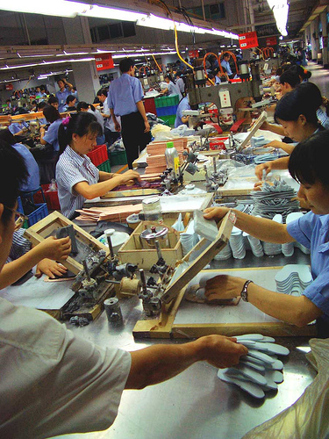
Types of Organizations (Contd.)
  The following figure depicts the manufacturing-based organization.
Notes:
Use the slide and the next slide to initiate a classroom discussion by introducing business processes and the need to be familiar with them in any business organization.
Organizational Setup
Based on Profit
All organizations work for commercial gain. Examples of organizations that are based on profit include:
NIIT, Wipro, and Ranbaxy.
However, some organizations may not have commercial gains as the key focus area. Examples include:
Red Cross and World Health Organization (WHO). Red Cross collects money in the form of charity and donations, and then utilizes these funds for providing social services to the people.
Based on System Type
A system is a group of interdependent components that perform their respective functions to achieve the end objective or goal of the organization.
An organization’s system type should be steadied in isolation. The same system could be considered open or closed depending on the perspective and the factors one is considering for discussion.
Cite the following examples while discussing the classification of organizations based on system types:
Simple/Complex:
Consultancy firms in the corporate world have a limited number of processes, but these are well defined.
Architects on the other hand do not have any well-defined processes.
Adaptive/Non Adaptive:
The size, complexity and functions that an organization carries to meet its objectives define the type of system it adopts or adapts. The food industry is very adaptive as compared to the automobile industry. The automobile industry needs to take many more factors into account before deciding on a change.
Usually bigger companies take a longer time to adapt as compared to the smaller ones.
In traditional systems performance, measurement parameters and scope are missing, for example the government-run departments. Traditional systems are driven by a 'boss', but contemporary systems are driven by a 'leader'.
Based on Ownership
A Corporation is organized and governed by articles of law. Examples of some laws: Companies Act, 1956, Competition Act, 2002, etc.
Sole proprietorship:
Advantages: Sole proprietorship is simple and flexible. The business set up can be established, bought, sold, modified or closed in a short time span. No organizational level charters or bylaws are required for this type of business venture. Other than the normal permits or licenses required for any business activity, no public notifications or legal issues are required for starting, terminating, redirecting, or modifying the business. A single family (proprietor) can own the business so the size or the complexity of the business can change if the proprietor has the finances available.
Limitations: The proprietor and family own the risk both personally and professionally unless assets (the property or funds owned by an individual or organization) are safeguarded, by creating a trust or treating them as separate entities. There may not be enough resources to support the business and hence limited capacity to respond to business opportunities. The business might end with the demise of the proprietor so the next generation must purchase or inherit the business assets by paying the applicable taxes and costs. Merging of household and business finances makes it difficult to measure the performance of the business in terms of profitability and performance. Conflicts in the family, if the family is involved in the business, can paralyze the business processes and functions leading to loss of revenue.

Slide 8
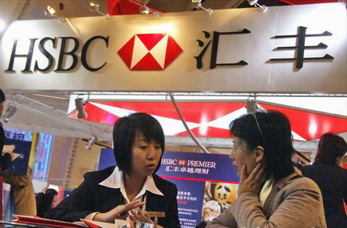
Types of Organizations (Contd.)
  The following figure depicts the service-based organization.
Notes:
Use the slide and the next slide to initiate a classroom discussion by introducing business processes and the need to be familiar with them in any business organization.
Organizational Setup
Based on Profit
All organizations work for commercial gain. Examples of organizations that are based on profit include:
NIIT, Wipro, and Ranbaxy.
However, some organizations may not have commercial gains as the key focus area. Examples include:
Red Cross and World Health Organization (WHO). Red Cross collects money in the form of charity and donations, and then utilizes these funds for providing social services to the people.
Based on System Type
A system is a group of interdependent components that perform their respective functions to achieve the end objective or goal of the organization.
An organization’s system type should be steadied in isolation. The same system could be considered open or closed depending on the perspective and the factors one is considering for discussion.
Cite the following examples while discussing the classification of organizations based on system types:
Simple/Complex:
Consultancy firms in the corporate world have a limited number of processes, but these are well defined.
Architects on the other hand do not have any well-defined processes.
Adaptive/Non Adaptive:
The size, complexity and functions that an organization carries to meet its objectives define the type of system it adopts or adapts. The food industry is very adaptive as compared to the automobile industry. The automobile industry needs to take many more factors into account before deciding on a change.
Usually bigger companies take a longer time to adapt as compared to the smaller ones.
In traditional systems performance, measurement parameters and scope are missing, for example the government-run departments. Traditional systems are driven by a 'boss', but contemporary systems are driven by a 'leader'.
Based on Ownership
A Corporation is organized and governed by articles of law. Examples of some laws: Companies Act, 1956, Competition Act, 2002, etc.
Sole proprietorship:
Advantages: Sole proprietorship is simple and flexible. The business set up can be established, bought, sold, modified or closed in a short time span. No organizational level charters or bylaws are required for this type of business venture. Other than the normal permits or licenses required for any business activity, no public notifications or legal issues are required for starting, terminating, redirecting, or modifying the business. A single family (proprietor) can own the business so the size or the complexity of the business can change if the proprietor has the finances available.
Limitations: The proprietor and family own the risk both personally and professionally unless assets (the property or funds owned by an individual or organization) are safeguarded, by creating a trust or treating them as separate entities. There may not be enough resources to support the business and hence limited capacity to respond to business opportunities. The business might end with the demise of the proprietor so the next generation must purchase or inherit the business assets by paying the applicable taxes and costs. Merging of household and business finances makes it difficult to measure the performance of the business in terms of profitability and performance. Conflicts in the family, if the family is involved in the business, can paralyze the business processes and functions leading to loss of revenue.

Slide 9
Types of Organizations (Contd.)
Based on profit:
  Organizations can be classified into the following types:
    Profit-based
    Nonprofit-based
Notes:
Use the slide and the next slide to initiate a classroom discussion by introducing business processes and the need to be familiar with them in any business organization.
Organizational Setup
Based on Profit
All organizations work for commercial gain. Examples of organizations that are based on profit include:
NIIT, Wipro, and Ranbaxy.
However, some organizations may not have commercial gains as the key focus area. Examples include:
Red Cross and World Health Organization (WHO). Red Cross collects money in the form of charity and donations, and then utilizes these funds for providing social services to the people.
Based on System Type
A system is a group of interdependent components that perform their respective functions to achieve the end objective or goal of the organization.
An organization’s system type should be steadied in isolation. The same system could be considered open or closed depending on the perspective and the factors one is considering for discussion.
Cite the following examples while discussing the classification of organizations based on system types:
Simple/Complex:
Consultancy firms in the corporate world have a limited number of processes, but these are well defined.
Architects on the other hand do not have any well-defined processes.
Adaptive/Non Adaptive:
The size, complexity and functions that an organization carries to meet its objectives define the type of system it adopts or adapts. The food industry is very adaptive as compared to the automobile industry. The automobile industry needs to take many more factors into account before deciding on a change.
Usually bigger companies take a longer time to adapt as compared to the smaller ones.
In traditional systems performance, measurement parameters and scope are missing, for example the government-run departments. Traditional systems are driven by a 'boss', but contemporary systems are driven by a 'leader'.
Based on Ownership
A Corporation is organized and governed by articles of law. Examples of some laws: Companies Act, 1956, Competition Act, 2002, etc.
Sole proprietorship:
Advantages: Sole proprietorship is simple and flexible. The business set up can be established, bought, sold, modified or closed in a short time span. No organizational level charters or bylaws are required for this type of business venture. Other than the normal permits or licenses required for any business activity, no public notifications or legal issues are required for starting, terminating, redirecting, or modifying the business. A single family (proprietor) can own the business so the size or the complexity of the business can change if the proprietor has the finances available.
Limitations: The proprietor and family own the risk both personally and professionally unless assets (the property or funds owned by an individual or organization) are safeguarded, by creating a trust or treating them as separate entities. There may not be enough resources to support the business and hence limited capacity to respond to business opportunities. The business might end with the demise of the proprietor so the next generation must purchase or inherit the business assets by paying the applicable taxes and costs. Merging of household and business finances makes it difficult to measure the performance of the business in terms of profitability and performance. Conflicts in the family, if the family is involved in the business, can paralyze the business processes and functions leading to loss of revenue.

Slide 10
Types of Organizations (Contd.)
Based on system type:
  Organizations can be classified into the following types:
    Simple
    Complex
    Adaptive
    Nonadaptive
Notes:
Use the slide and the next slide to initiate a classroom discussion by introducing business processes and the need to be familiar with them in any business organization.
Organizational Setup
Based on Profit
All organizations work for commercial gain. Examples of organizations that are based on profit include:
NIIT, Wipro, and Ranbaxy.
However, some organizations may not have commercial gains as the key focus area. Examples include:
Red Cross and World Health Organization (WHO). Red Cross collects money in the form of charity and donations, and then utilizes these funds for providing social services to the people.
Based on System Type
A system is a group of interdependent components that perform their respective functions to achieve the end objective or goal of the organization.
An organization’s system type should be steadied in isolation. The same system could be considered open or closed depending on the perspective and the factors one is considering for discussion.
Cite the following examples while discussing the classification of organizations based on system types:
Simple/Complex:
Consultancy firms in the corporate world have a limited number of processes, but these are well defined.
Architects on the other hand do not have any well-defined processes.
Adaptive/Non Adaptive:
The size, complexity and functions that an organization carries to meet its objectives define the type of system it adopts or adapts. The food industry is very adaptive as compared to the automobile industry. The automobile industry needs to take many more factors into account before deciding on a change.
Usually bigger companies take a longer time to adapt as compared to the smaller ones.
In traditional systems performance, measurement parameters and scope are missing, for example the government-run departments. Traditional systems are driven by a 'boss', but contemporary systems are driven by a 'leader'.
Based on Ownership
A Corporation is organized and governed by articles of law. Examples of some laws: Companies Act, 1956, Competition Act, 2002, etc.
Sole proprietorship:
Advantages: Sole proprietorship is simple and flexible. The business set up can be established, bought, sold, modified or closed in a short time span. No organizational level charters or bylaws are required for this type of business venture. Other than the normal permits or licenses required for any business activity, no public notifications or legal issues are required for starting, terminating, redirecting, or modifying the business. A single family (proprietor) can own the business so the size or the complexity of the business can change if the proprietor has the finances available.
Limitations: The proprietor and family own the risk both personally and professionally unless assets (the property or funds owned by an individual or organization) are safeguarded, by creating a trust or treating them as separate entities. There may not be enough resources to support the business and hence limited capacity to respond to business opportunities. The business might end with the demise of the proprietor so the next generation must purchase or inherit the business assets by paying the applicable taxes and costs. Merging of household and business finances makes it difficult to measure the performance of the business in terms of profitability and performance. Conflicts in the family, if the family is involved in the business, can paralyze the business processes and functions leading to loss of revenue.

Slide 11
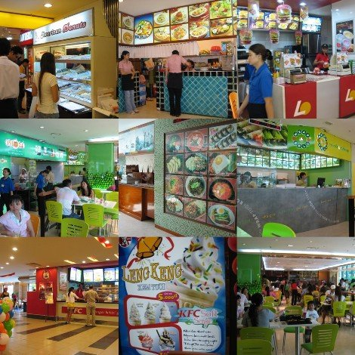
Types of Organizations (Contd.)
  The following figure depicts the restaurant, a simple organization.
Notes:
Use the slide and the next slide to initiate a classroom discussion by introducing business processes and the need to be familiar with them in any business organization.
Organizational Setup
Based on Profit
All organizations work for commercial gain. Examples of organizations that are based on profit include:
NIIT, Wipro, and Ranbaxy.
However, some organizations may not have commercial gains as the key focus area. Examples include:
Red Cross and World Health Organization (WHO). Red Cross collects money in the form of charity and donations, and then utilizes these funds for providing social services to the people.
Based on System Type
A system is a group of interdependent components that perform their respective functions to achieve the end objective or goal of the organization.
An organization’s system type should be steadied in isolation. The same system could be considered open or closed depending on the perspective and the factors one is considering for discussion.
Cite the following examples while discussing the classification of organizations based on system types:
Simple/Complex:
Consultancy firms in the corporate world have a limited number of processes, but these are well defined.
Architects on the other hand do not have any well-defined processes.
Adaptive/Non Adaptive:
The size, complexity and functions that an organization carries to meet its objectives define the type of system it adopts or adapts. The food industry is very adaptive as compared to the automobile industry. The automobile industry needs to take many more factors into account before deciding on a change.
Usually bigger companies take a longer time to adapt as compared to the smaller ones.
In traditional systems performance, measurement parameters and scope are missing, for example the government-run departments. Traditional systems are driven by a 'boss', but contemporary systems are driven by a 'leader'.
Based on Ownership
A Corporation is organized and governed by articles of law. Examples of some laws: Companies Act, 1956, Competition Act, 2002, etc.
Sole proprietorship:
Advantages: Sole proprietorship is simple and flexible. The business set up can be established, bought, sold, modified or closed in a short time span. No organizational level charters or bylaws are required for this type of business venture. Other than the normal permits or licenses required for any business activity, no public notifications or legal issues are required for starting, terminating, redirecting, or modifying the business. A single family (proprietor) can own the business so the size or the complexity of the business can change if the proprietor has the finances available.
Limitations: The proprietor and family own the risk both personally and professionally unless assets (the property or funds owned by an individual or organization) are safeguarded, by creating a trust or treating them as separate entities. There may not be enough resources to support the business and hence limited capacity to respond to business opportunities. The business might end with the demise of the proprietor so the next generation must purchase or inherit the business assets by paying the applicable taxes and costs. Merging of household and business finances makes it difficult to measure the performance of the business in terms of profitability and performance. Conflicts in the family, if the family is involved in the business, can paralyze the business processes and functions leading to loss of revenue.

Slide 12
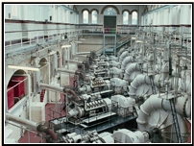
Types of Organizations (Contd.)
  The following figure depicts the car manufacturing unit, a complex organization.
Notes:
Use the slide and the next slide to initiate a classroom discussion by introducing business processes and the need to be familiar with them in any business organization.
Organizational Setup
Based on Profit
All organizations work for commercial gain. Examples of organizations that are based on profit include:
NIIT, Wipro, and Ranbaxy.
However, some organizations may not have commercial gains as the key focus area. Examples include:
Red Cross and World Health Organization (WHO). Red Cross collects money in the form of charity and donations, and then utilizes these funds for providing social services to the people.
Based on System Type
A system is a group of interdependent components that perform their respective functions to achieve the end objective or goal of the organization.
An organization’s system type should be steadied in isolation. The same system could be considered open or closed depending on the perspective and the factors one is considering for discussion.
Cite the following examples while discussing the classification of organizations based on system types:
Simple/Complex:
Consultancy firms in the corporate world have a limited number of processes, but these are well defined.
Architects on the other hand do not have any well-defined processes.
Adaptive/Non Adaptive:
The size, complexity and functions that an organization carries to meet its objectives define the type of system it adopts or adapts. The food industry is very adaptive as compared to the automobile industry. The automobile industry needs to take many more factors into account before deciding on a change.
Usually bigger companies take a longer time to adapt as compared to the smaller ones.
In traditional systems performance, measurement parameters and scope are missing, for example the government-run departments. Traditional systems are driven by a 'boss', but contemporary systems are driven by a 'leader'.
Based on Ownership
A Corporation is organized and governed by articles of law. Examples of some laws: Companies Act, 1956, Competition Act, 2002, etc.
Sole proprietorship:
Advantages: Sole proprietorship is simple and flexible. The business set up can be established, bought, sold, modified or closed in a short time span. No organizational level charters or bylaws are required for this type of business venture. Other than the normal permits or licenses required for any business activity, no public notifications or legal issues are required for starting, terminating, redirecting, or modifying the business. A single family (proprietor) can own the business so the size or the complexity of the business can change if the proprietor has the finances available.
Limitations: The proprietor and family own the risk both personally and professionally unless assets (the property or funds owned by an individual or organization) are safeguarded, by creating a trust or treating them as separate entities. There may not be enough resources to support the business and hence limited capacity to respond to business opportunities. The business might end with the demise of the proprietor so the next generation must purchase or inherit the business assets by paying the applicable taxes and costs. Merging of household and business finances makes it difficult to measure the performance of the business in terms of profitability and performance. Conflicts in the family, if the family is involved in the business, can paralyze the business processes and functions leading to loss of revenue.

Slide 13

Types of Organizations (Contd.)
  The following figure depicts the fashion industry, an adaptive organization.
Notes:
Use the slide and the next slide to initiate a classroom discussion by introducing business processes and the need to be familiar with them in any business organization.
Organizational Setup
Based on Profit
All organizations work for commercial gain. Examples of organizations that are based on profit include:
NIIT, Wipro, and Ranbaxy.
However, some organizations may not have commercial gains as the key focus area. Examples include:
Red Cross and World Health Organization (WHO). Red Cross collects money in the form of charity and donations, and then utilizes these funds for providing social services to the people.
Based on System Type
A system is a group of interdependent components that perform their respective functions to achieve the end objective or goal of the organization.
An organization’s system type should be steadied in isolation. The same system could be considered open or closed depending on the perspective and the factors one is considering for discussion.
Cite the following examples while discussing the classification of organizations based on system types:
Simple/Complex:
Consultancy firms in the corporate world have a limited number of processes, but these are well defined.
Architects on the other hand do not have any well-defined processes.
Adaptive/Non Adaptive:
The size, complexity and functions that an organization carries to meet its objectives define the type of system it adopts or adapts. The food industry is very adaptive as compared to the automobile industry. The automobile industry needs to take many more factors into account before deciding on a change.
Usually bigger companies take a longer time to adapt as compared to the smaller ones.
In traditional systems performance, measurement parameters and scope are missing, for example the government-run departments. Traditional systems are driven by a 'boss', but contemporary systems are driven by a 'leader'.
Based on Ownership
A Corporation is organized and governed by articles of law. Examples of some laws: Companies Act, 1956, Competition Act, 2002, etc.
Sole proprietorship:
Advantages: Sole proprietorship is simple and flexible. The business set up can be established, bought, sold, modified or closed in a short time span. No organizational level charters or bylaws are required for this type of business venture. Other than the normal permits or licenses required for any business activity, no public notifications or legal issues are required for starting, terminating, redirecting, or modifying the business. A single family (proprietor) can own the business so the size or the complexity of the business can change if the proprietor has the finances available.
Limitations: The proprietor and family own the risk both personally and professionally unless assets (the property or funds owned by an individual or organization) are safeguarded, by creating a trust or treating them as separate entities. There may not be enough resources to support the business and hence limited capacity to respond to business opportunities. The business might end with the demise of the proprietor so the next generation must purchase or inherit the business assets by paying the applicable taxes and costs. Merging of household and business finances makes it difficult to measure the performance of the business in terms of profitability and performance. Conflicts in the family, if the family is involved in the business, can paralyze the business processes and functions leading to loss of revenue.

Slide 14
Types of Organizations (Contd.)
Based on ownership:
  Organizations can be classified into the following types:
    Sole Proprietorship (Single Ownership)
    Partnership
    Corporation (Company)
Notes:
Use the slide and the next slide to initiate a classroom discussion by introducing business processes and the need to be familiar with them in any business organization.
Organizational Setup
Based on Profit
All organizations work for commercial gain. Examples of organizations that are based on profit include:
NIIT, Wipro, and Ranbaxy.
However, some organizations may not have commercial gains as the key focus area. Examples include:
Red Cross and World Health Organization (WHO). Red Cross collects money in the form of charity and donations, and then utilizes these funds for providing social services to the people.
Based on System Type
A system is a group of interdependent components that perform their respective functions to achieve the end objective or goal of the organization.
An organization’s system type should be steadied in isolation. The same system could be considered open or closed depending on the perspective and the factors one is considering for discussion.
Cite the following examples while discussing the classification of organizations based on system types:
Simple/Complex:
Consultancy firms in the corporate world have a limited number of processes, but these are well defined.
Architects on the other hand do not have any well-defined processes.
Adaptive/Non Adaptive:
The size, complexity and functions that an organization carries to meet its objectives define the type of system it adopts or adapts. The food industry is very adaptive as compared to the automobile industry. The automobile industry needs to take many more factors into account before deciding on a change.
Usually bigger companies take a longer time to adapt as compared to the smaller ones.
In traditional systems performance, measurement parameters and scope are missing, for example the government-run departments. Traditional systems are driven by a 'boss', but contemporary systems are driven by a 'leader'.
Based on Ownership
A Corporation is organized and governed by articles of law. Examples of some laws: Companies Act, 1956, Competition Act, 2002, etc.
Sole proprietorship:
Advantages: Sole proprietorship is simple and flexible. The business set up can be established, bought, sold, modified or closed in a short time span. No organizational level charters or bylaws are required for this type of business venture. Other than the normal permits or licenses required for any business activity, no public notifications or legal issues are required for starting, terminating, redirecting, or modifying the business. A single family (proprietor) can own the business so the size or the complexity of the business can change if the proprietor has the finances available.
Limitations: The proprietor and family own the risk both personally and professionally unless assets (the property or funds owned by an individual or organization) are safeguarded, by creating a trust or treating them as separate entities. There may not be enough resources to support the business and hence limited capacity to respond to business opportunities. The business might end with the demise of the proprietor so the next generation must purchase or inherit the business assets by paying the applicable taxes and costs. Merging of household and business finances makes it difficult to measure the performance of the business in terms of profitability and performance. Conflicts in the family, if the family is involved in the business, can paralyze the business processes and functions leading to loss of revenue.

Slide 15
Organizational Structure and Roles
What is an organizational structure?
Notes:
Use this and the following three slides to explain the functional, project, and multi-dimensional organizational structures to the students.

Slide 16
Organizational Structure and Roles (Contd.)
These elements may include people, resources, market trends, levels of competence, and reward systems.
An organizational structure is the sum of interaction between individual elements within the organization.
Notes:
Use this and the following three slides to explain the functional, project, and multi-dimensional organizational structures to the students.

Slide 17
Organizational Structure and Roles (Contd.)
An organization can be structured based on the following categories:
  Functional Organizational Structure:
    The flow of decisions is top-down.
  Project Organizational Structure:
    It caters to different projects that center around main products or services.
  Multi-Dimensional Organizational Structure:
    It incorporates several different structures at the same time.
Notes:
Use this and the following three slides to explain the functional, project, and multi-dimensional organizational structures to the students.

Slide 18
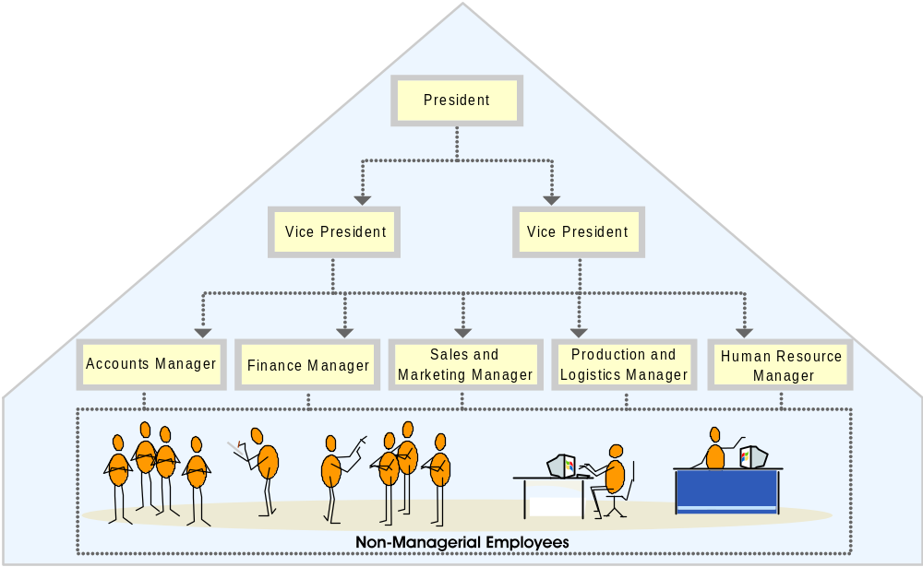
Organizational Structure and Roles (Contd.)
The following figure depicts the hierarchy of a Functional Organizational Structure.

Slide 19
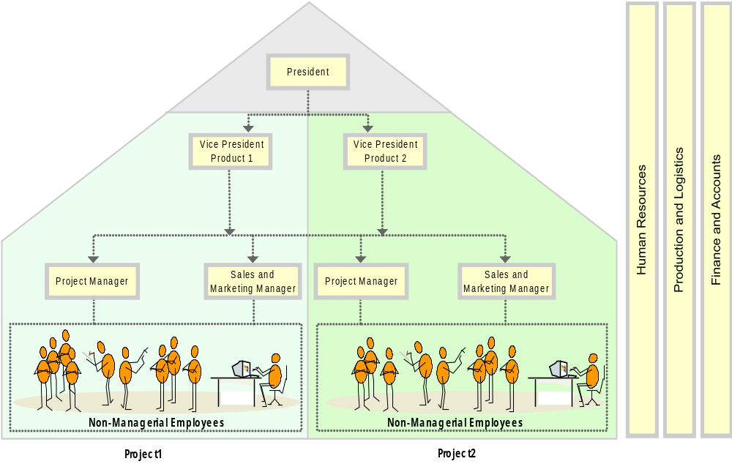
Organizational Structure and Roles (Contd.)
The following figure depicts the Project Organizational Structure.

Slide 20
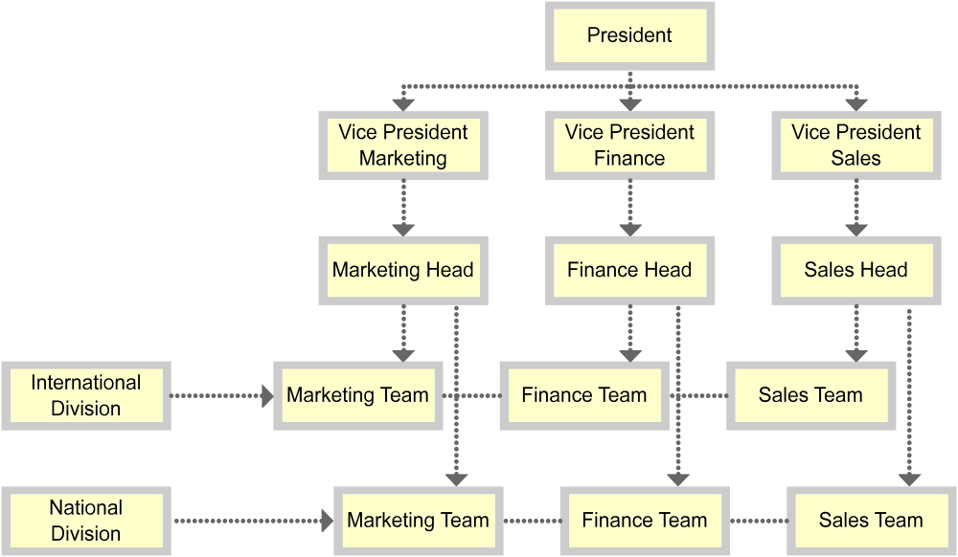
Organizational Structure and Roles (Contd.)
The following figure depicts the Multi-dimensional Organizational Structure.

Slide 21
Business Ethics and Values
Business ethics and values refer to principles and standards that determine acceptable conduct in business.
Some ethical issues faced by organizations are:
  Business integrity
  Security of customer information
  Job discrimination
  Business principle adherence
  Workplace safety
  Environmental and social issues
  Policies and contracts of organization
  Shareholder interests
Notes:
Use this slide to explain the business ethics and values to the students with the help of examples.
Business Ethics and Values
Examples that can be cited while explaining various issues that deal with business ethics. For the customer information privacy, example of Hotmail can be used where e-mail addresses of customers were sold to companies for commercial gains.
Social and environmental issues: Example: Soon after their arrival in India, McDonalds, the multinational chain, had to Modify and customize their menu to suit the Indian palate. Moreover, it became mandatory to segregate their non-vegetarian burgers from the vegetarian ones in keeping with religious sentiments in the country.
Non-ethical issues include the employment of child labor in factories, such as those producing matchsticks and firecrackers.

Slide 22
Summary
In this session, you learned that:
  Organizations may be categorized based on the following business needs:
    Nature of work
    Profitability
    Type of system
    Ownership
  An organization can be structured based on the following categories:
    Functional Organizational Structure
    Project Organizational Structure
    Multi-dimensional Organizational Structure
Notes:
Use this and the following slides to summarize the key concepts of the session to the students.

Slide 23
Summary (Contd.)
  Business ethics refer to principles and standards that determine acceptable conduct in business.
  Business integrity, shareholders interests, and job discrimination are some of the ethical issues faced by managers.
Notes:
Use this and the following slides to summarize the key concepts of the session to the students.

